Slide 1
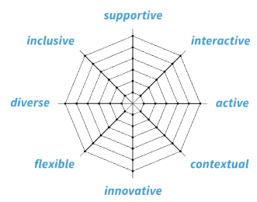
Blueprint course:
Who are your learners
Online Learning Experience
What do they need?
Mission statement
Look & Feel
Quote
Your course in 1 sentence
What would you like your learners to say after taking the course?
Learning objectives
Assessment
This work by TU Delft TLS is licensed under CC-BY-NC-SA 4.0 | version July 2019 | online-learning@tudelft.nl

